Slide 1
Model Pruning
2024.4.25

Slide 2
Model Pruning
2. Towards Meta-Pruning via Optimal Transport.
ICLR 2024 spotlight.
3. Accurate Retraining-free Pruning for Pretrained Encoder-based Language Models.
ICLR 2024 poster.

Slide 3
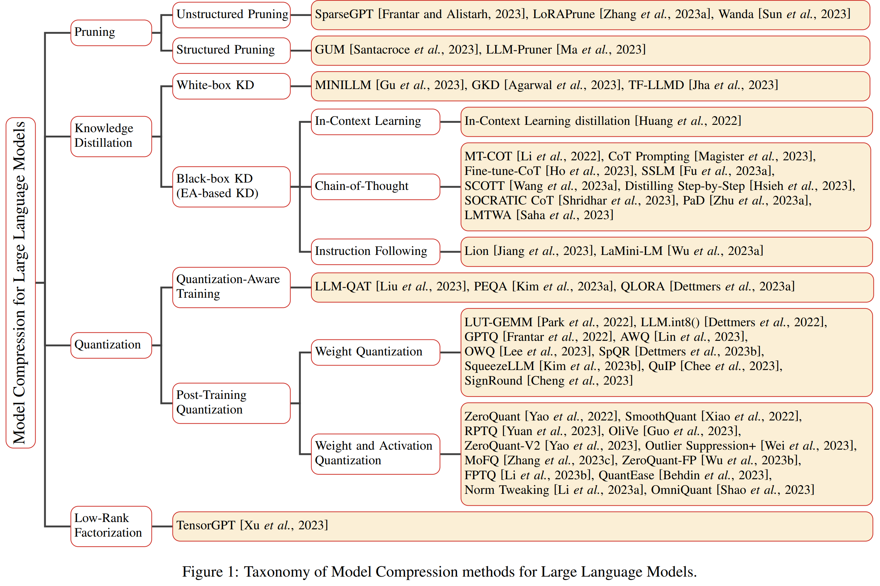
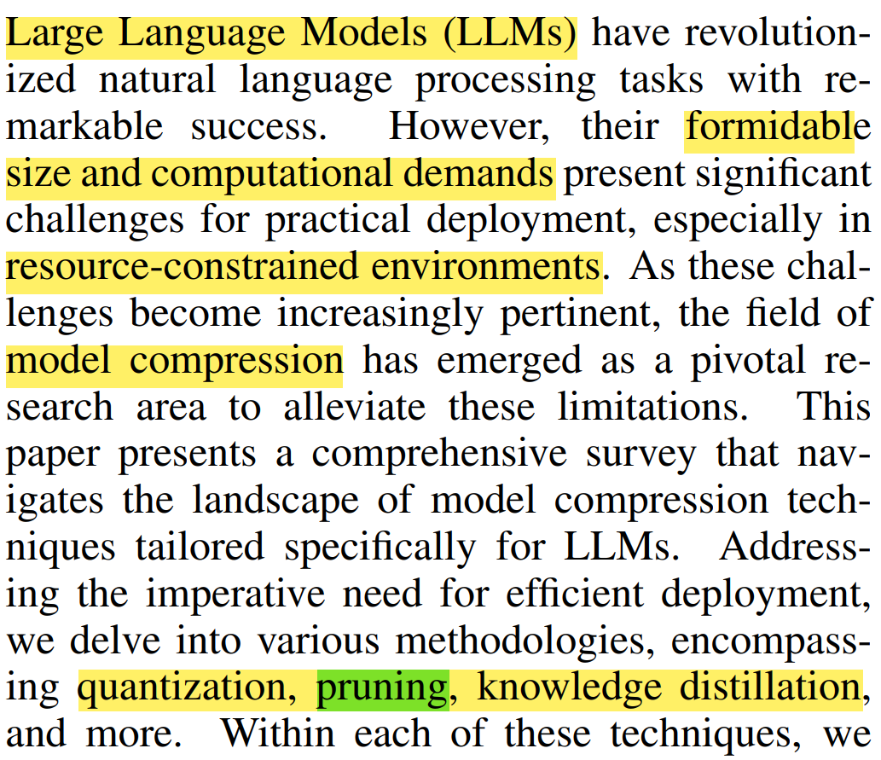
Background

Slide 4
Model Pruning
Pruning reduces the size or complexity of a model by removing unnecessary or redundant parameters have little even no effects on the performance of the model
+ make the model storage-friendly, memory-efficiency, computation-efficiency.
Pruning can be divided into Unstructured Pruning and Structured Pruning. The main difference between them lies in the pruning targets and the resulting network structure.
Structured pruning removes connections or hierarchical structures, such as neurons, channels, or layers based on specific rules based on the overall network structure.
On the other hand, unstructured pruning prunes individual parameters, resulting in an irregular sparse structure. This approach targets individual weights or neurons in the LLM, usually by applying a threshold to zero out parameters below it.

Slide 5
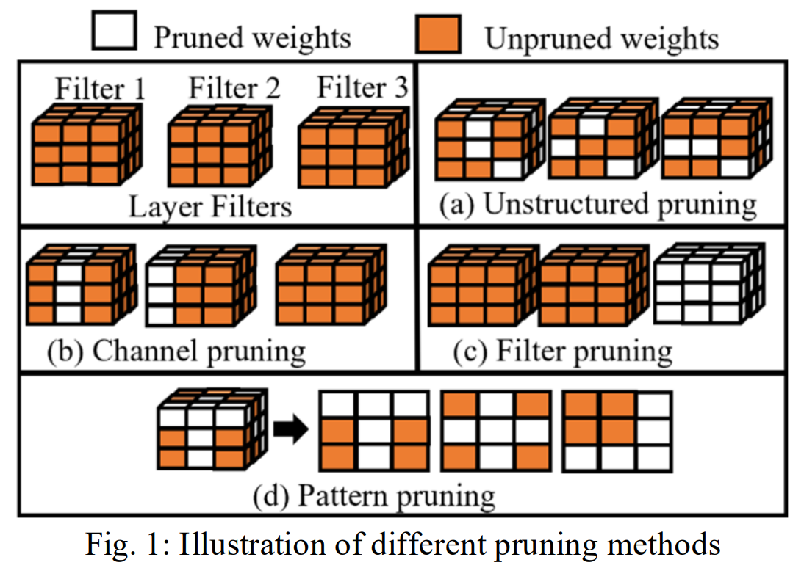
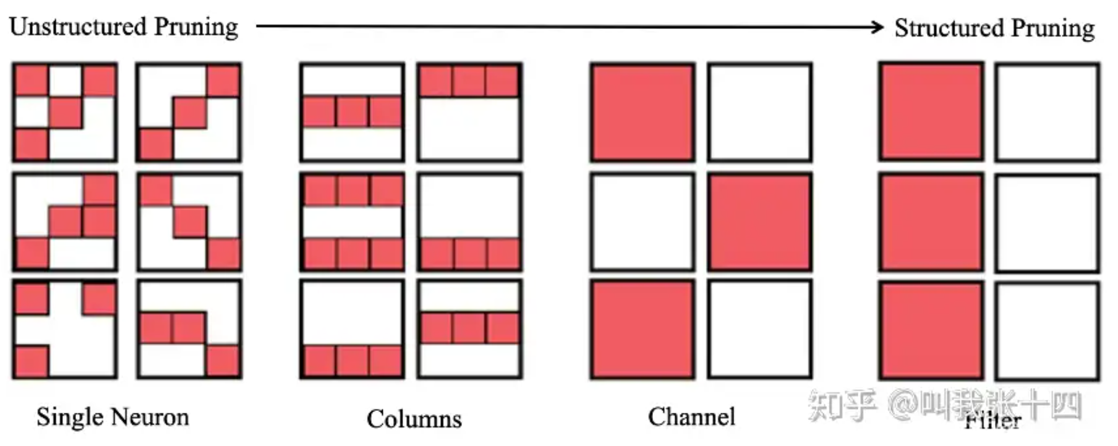

Slide 6
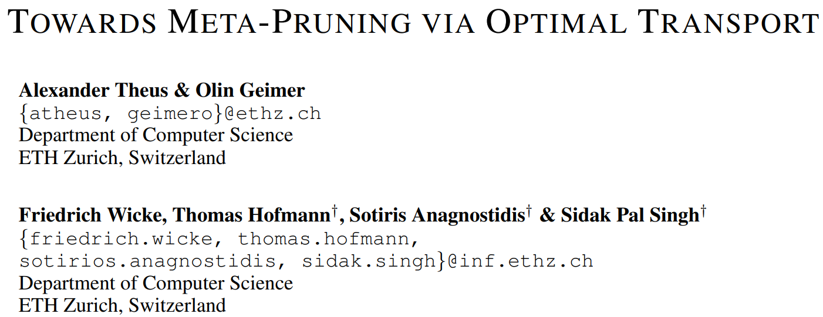
ICLR 2024 spotlight

Slide 7
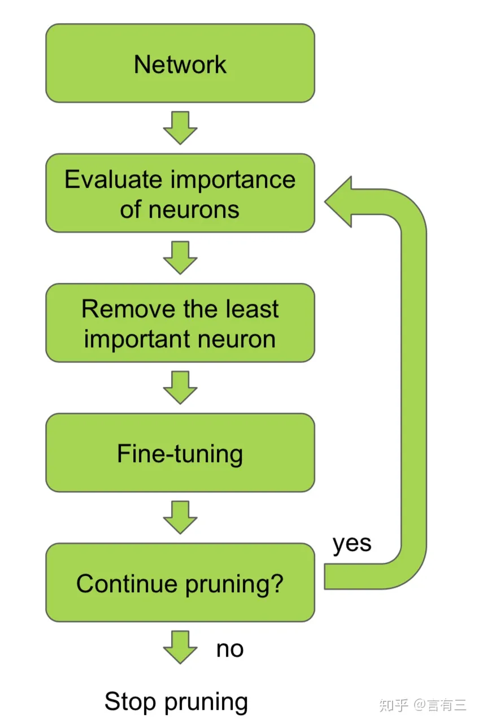
Importance √
Previous methods
Model Fusion (Data-Free)

Slide 8
Motivation: Structural pruning → significant accuracy ↓
Keep the most important neurons, discard the rest. → fine-tuning
Fine-tuning → Data (epoch)
Contributions:
Intra-Fusion leverages Optimal Transport to additionally inform the process of model compression with the neurons that otherwise would have been discarded
Data-Free pruning: Pruning neural networks generally leads to immediate drops in accuracy, hence requiring an extensive fine-tuning step to be usable in a practical setting. Intra-Fusion, a significant amount of accuracy can be recovered without the need for any datapoints.
Split-Data Training: Models that are to be pruned after training are most often fine-tuned for many epochs to regain sufficient performance. Via the presented ‘PaF’ and ‘FaP’ approaches, we factorize this process through the combination of model pruning and model fusion. By splitting the training dataset into multiple parts, over which models are trained concurrently, we achieve significant training time speedups.

Slide 9
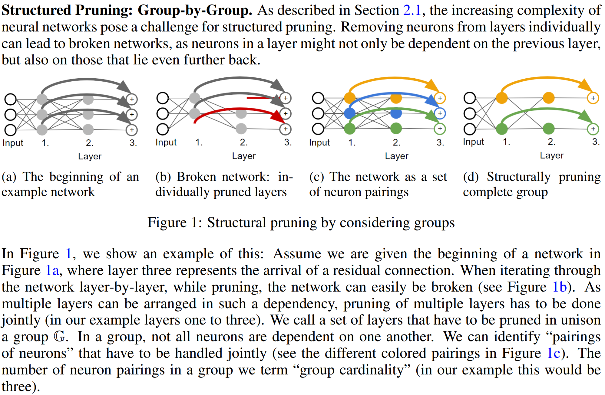

Slide 10
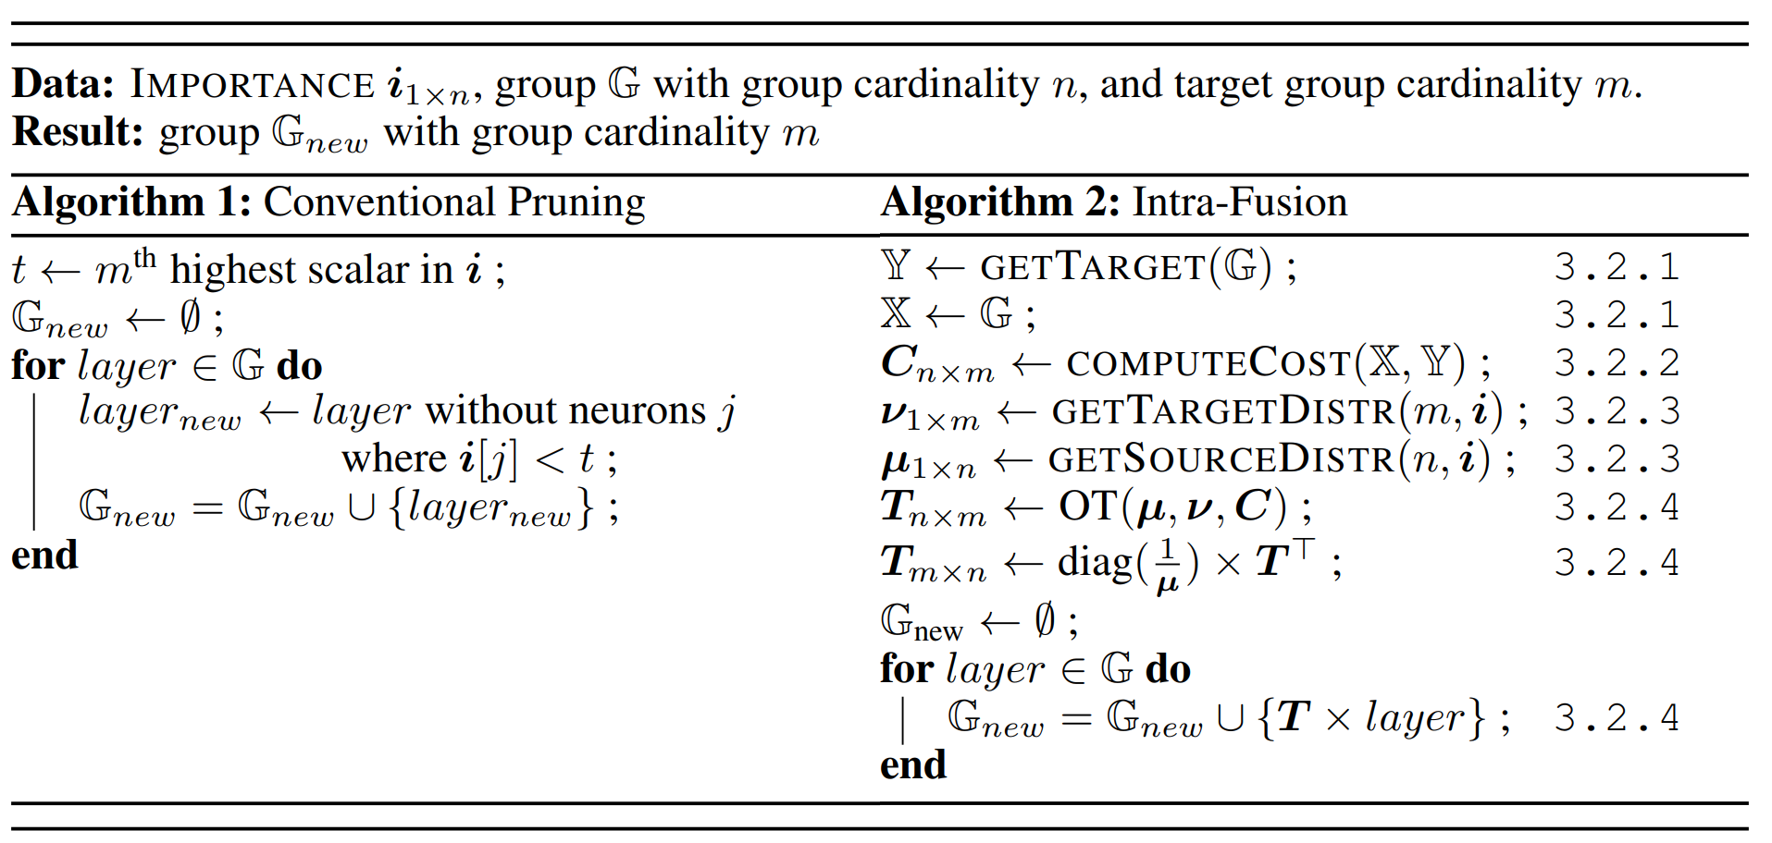

Slide 11
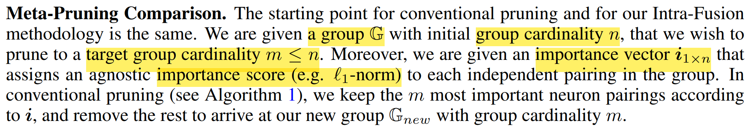
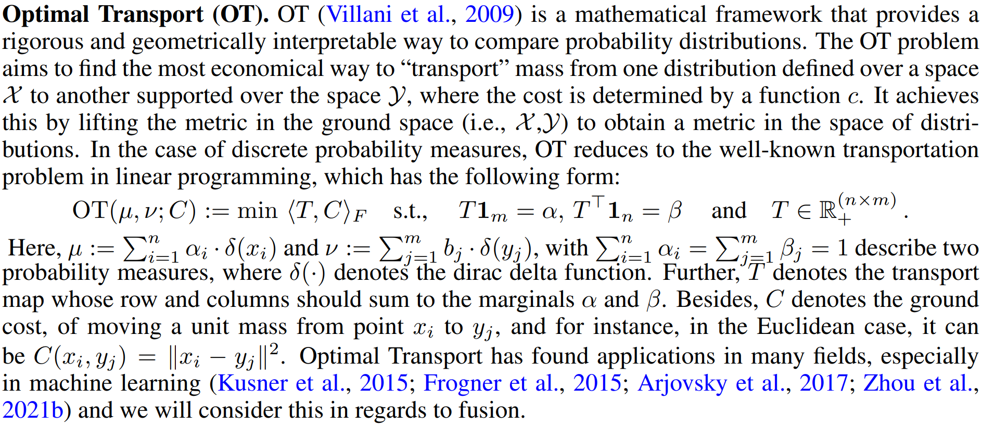

Slide 12
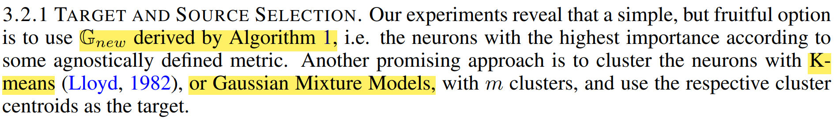
Two distributions:
Cost function:

Slide 13
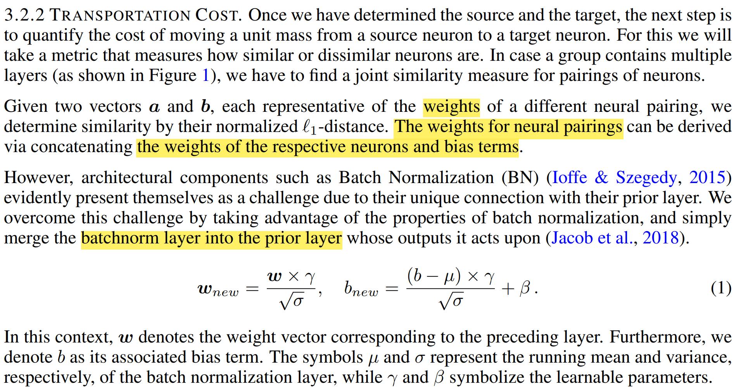

Slide 14
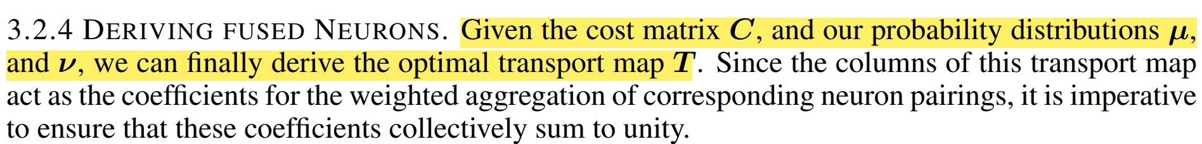
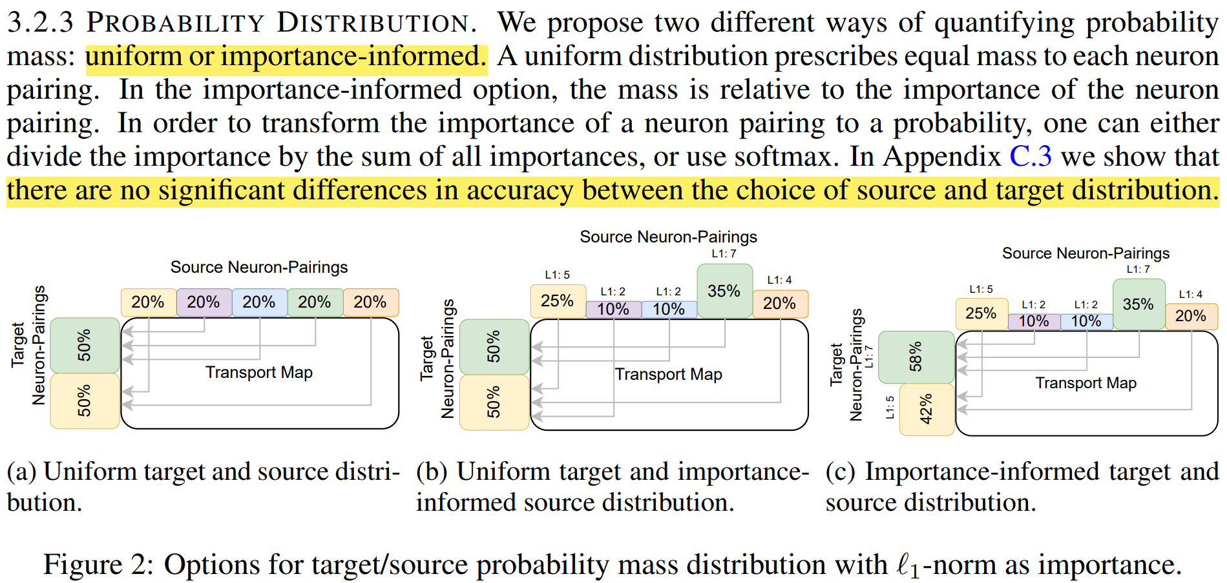

Slide 15
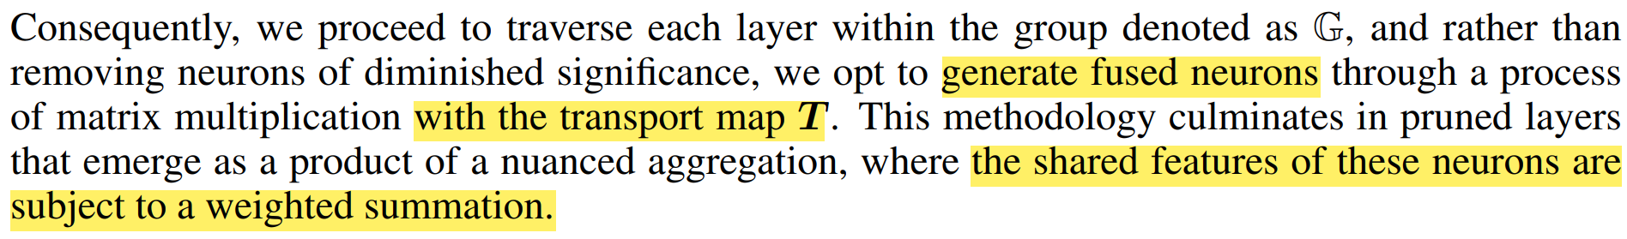

Slide 16
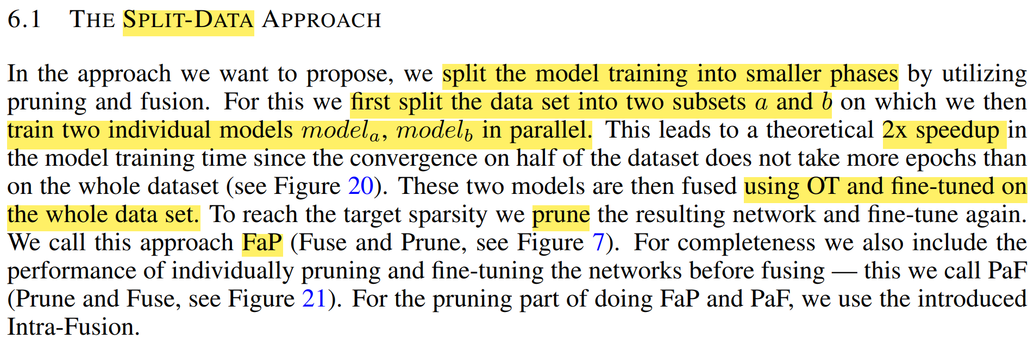
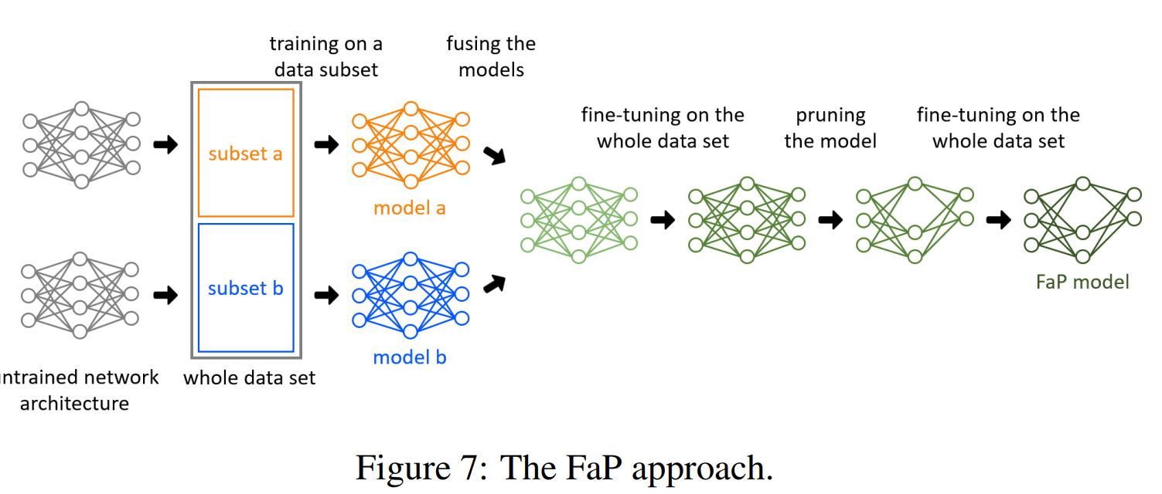

Slide 17
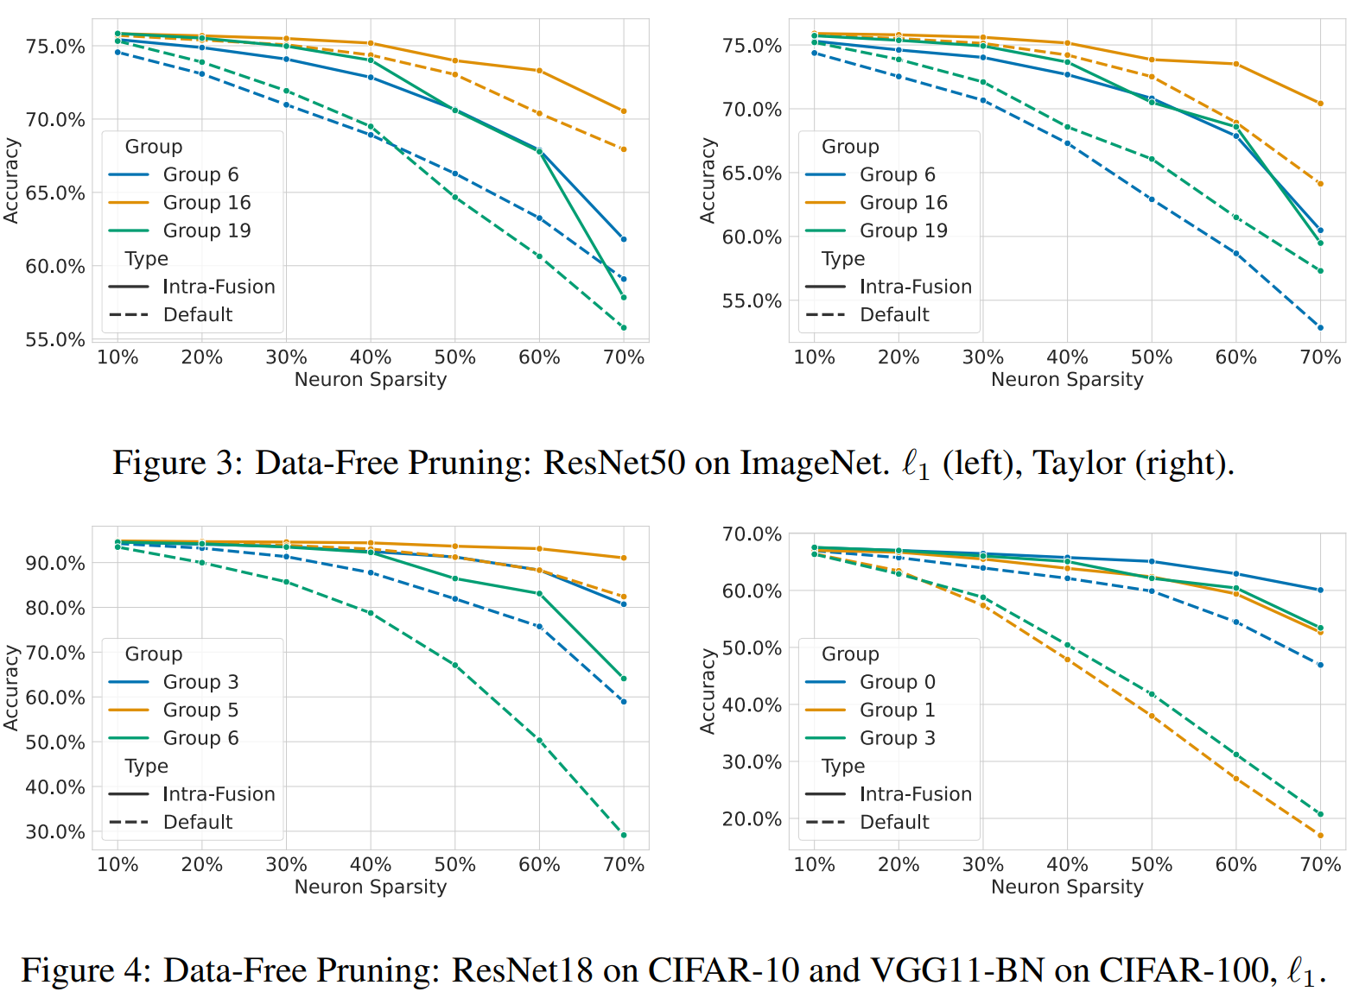

Slide 18
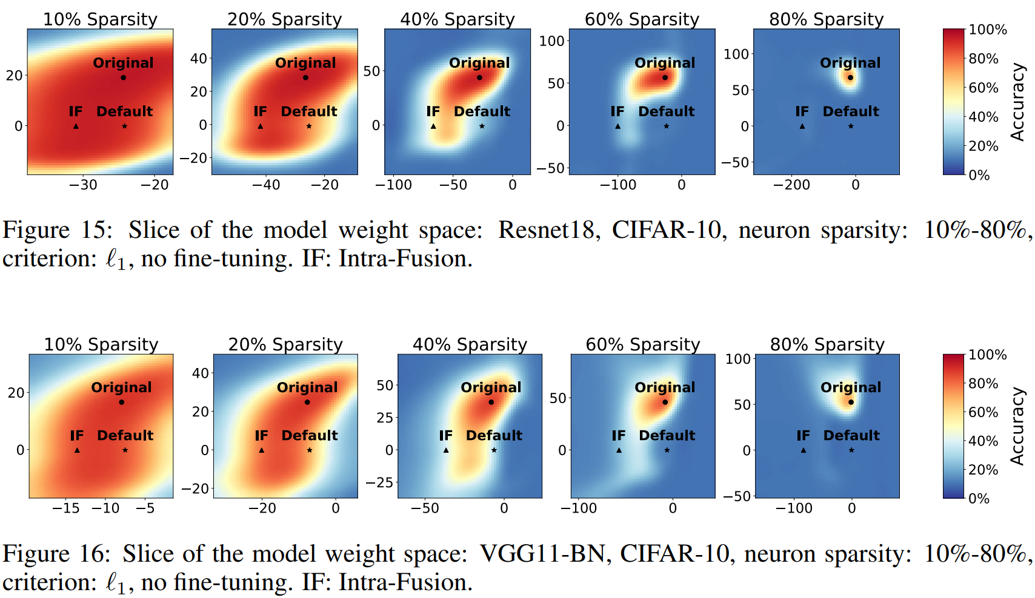

Slide 19
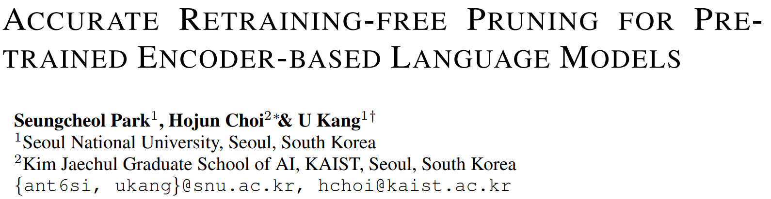
ICLR 2024 poster

Slide 20
Motivation: Structured pruning algorithms significantly reduced pruning cost and capability to prune large language models. How can we accurately compress pretrained encoder-based language models (PLMs) without retraining?
Contributions:
Algorithm. We propose K-prune, an accurate retraining-free pruning algorithm for PLMs. K-prune consists of three novel ideas to preserve the useful knowledge of the pretrained models: knowledge measurement, knowledge-preserving mask search, and knowledge-preserving weight-tuning.
Accuracy. We perform extensive experiments on GLUE and SQuAD benchmarks to demonstrate the performance of K-prune. K-prune shows up to 58.02%p higher F1 score than the best results of existing retraining-free algorithms under a high compression rate of 80%.
Efficiency. We demonstrate that K-prune shows the best accuracy-cost trade-off among the state-of-the-art pruning algorithms. K-prune shows comparable or higher accuracy than retraining-based algorithms on GLUE benchmarks with up to 422× lower pruning cost.

Slide 21
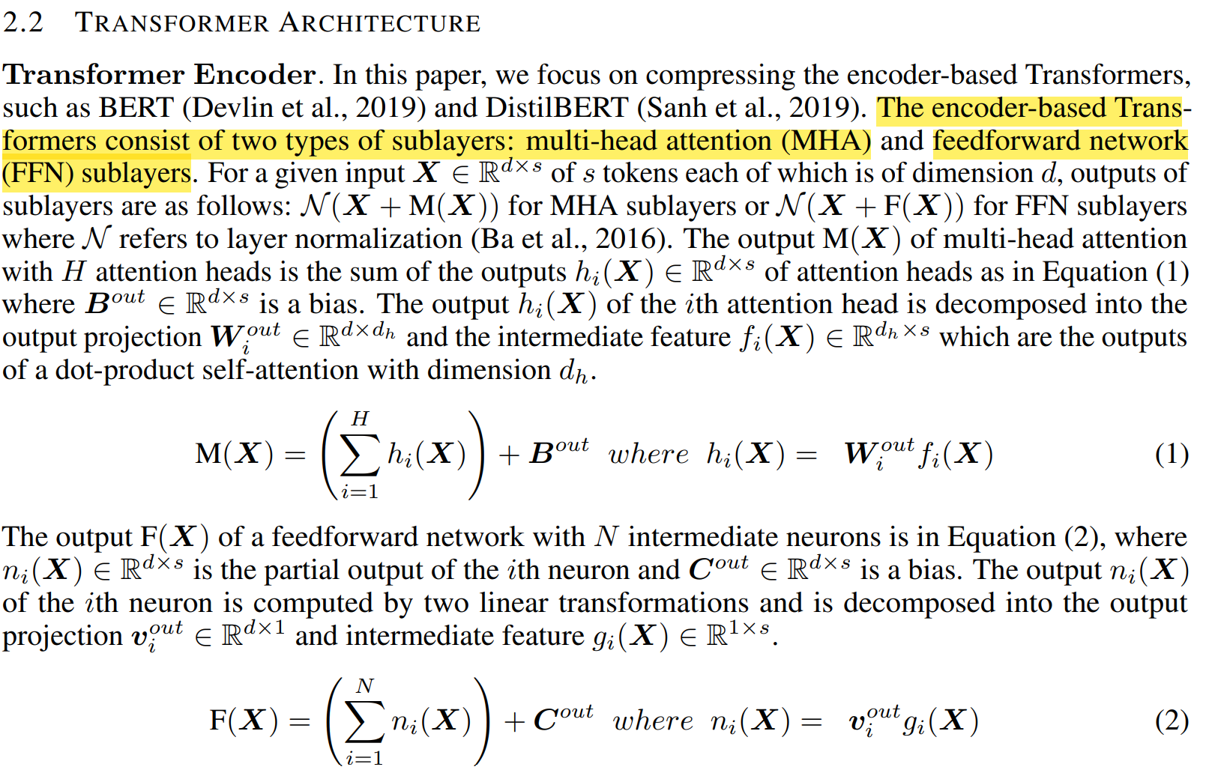

Slide 22
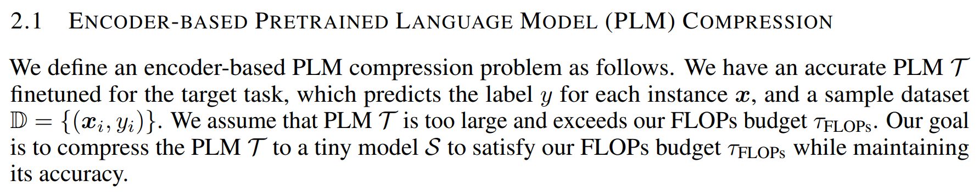
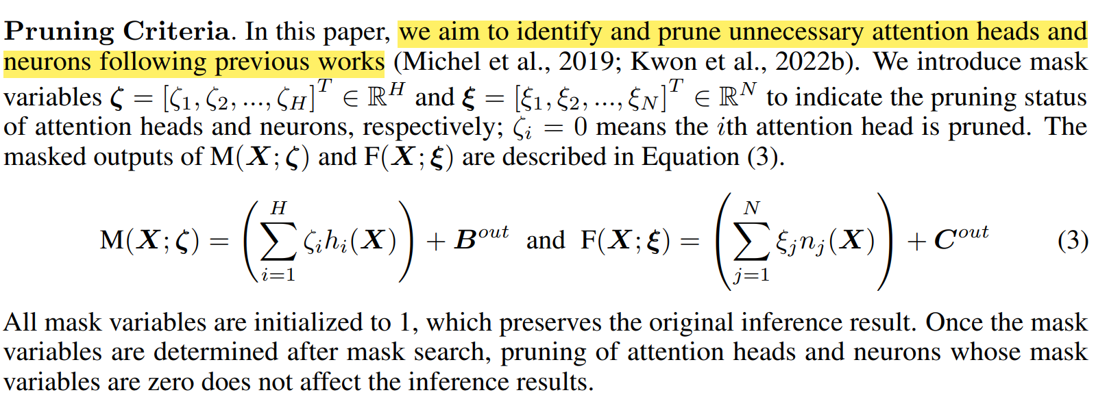

Slide 23
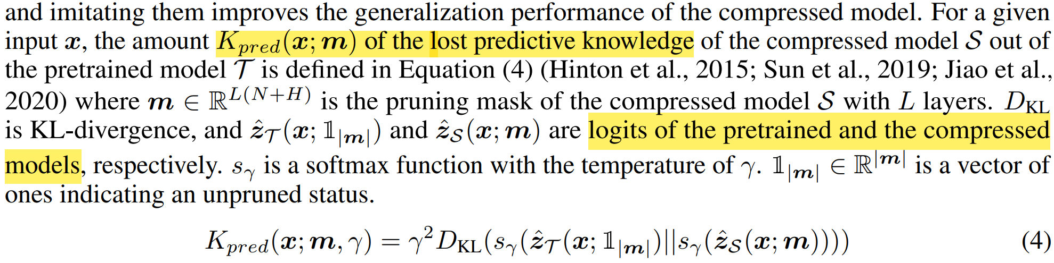
Knowledge?
Prediction

Slide 24
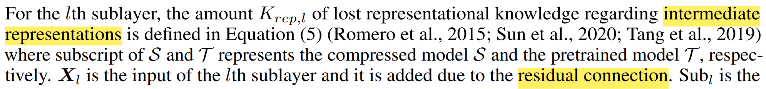
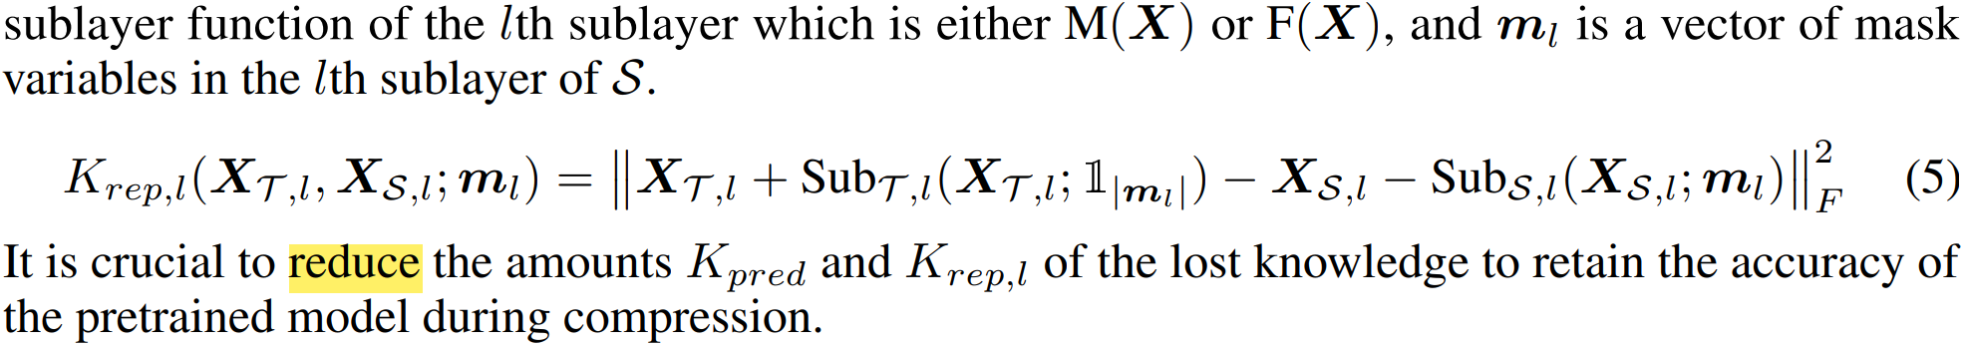
Knowledge?
Intermediate representations

Slide 25
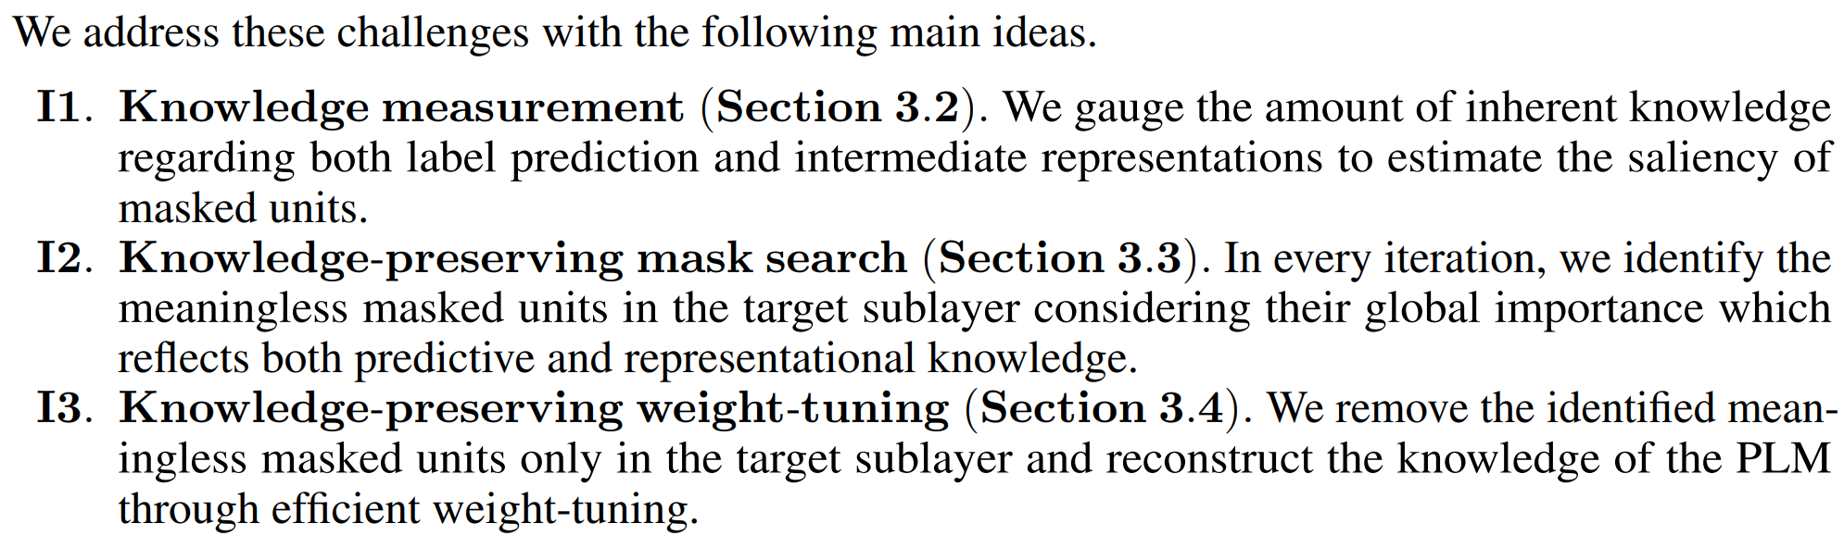

Slide 26
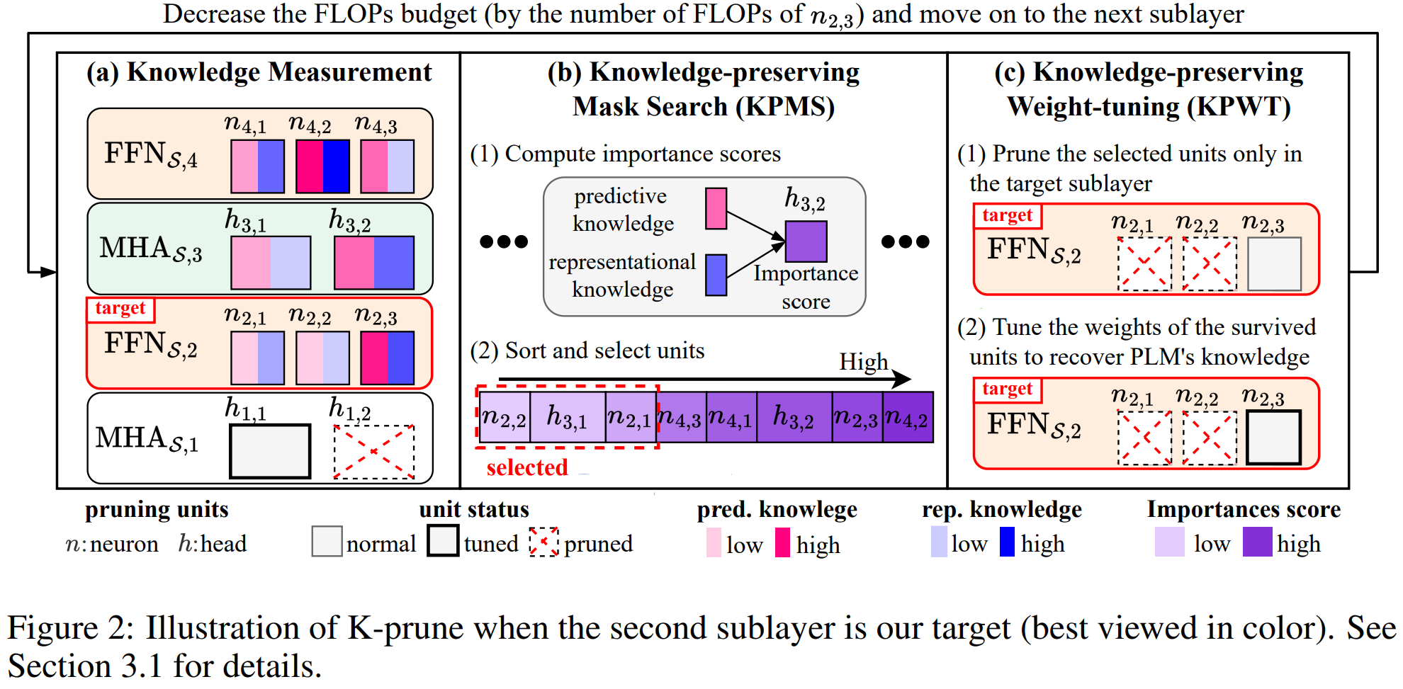

Slide 27
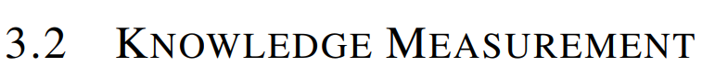
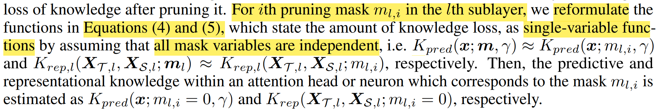

Slide 28
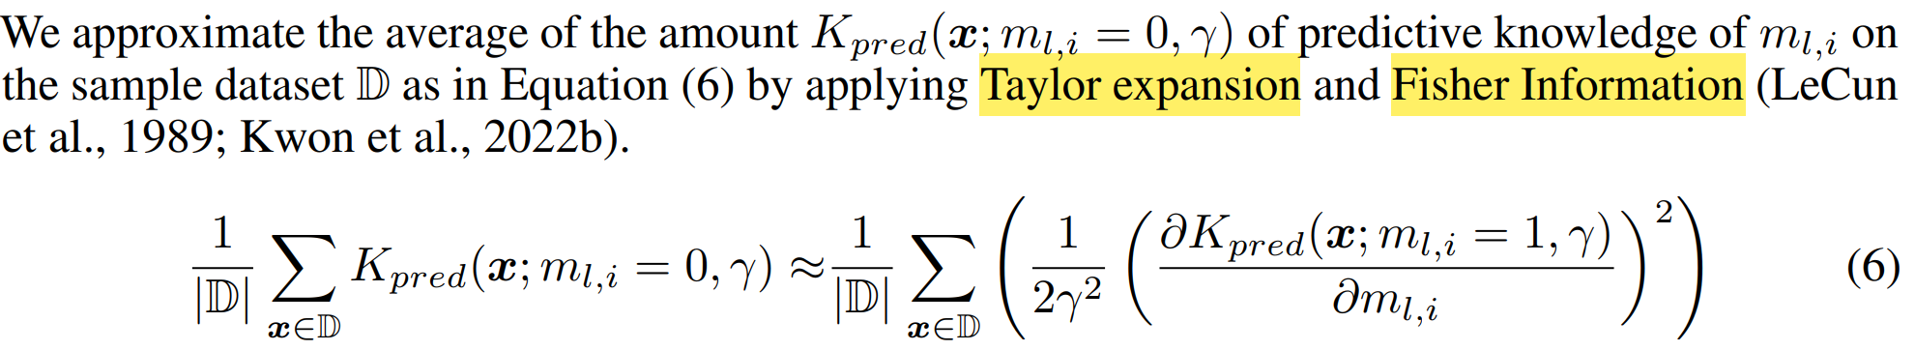
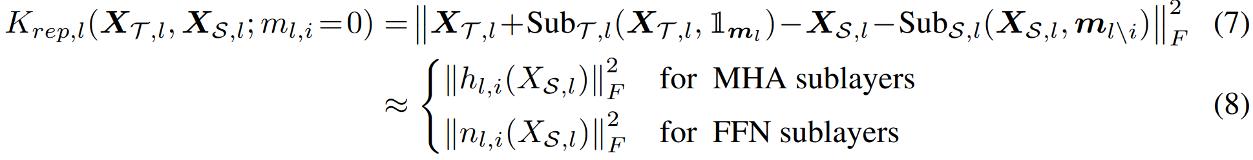

Slide 29
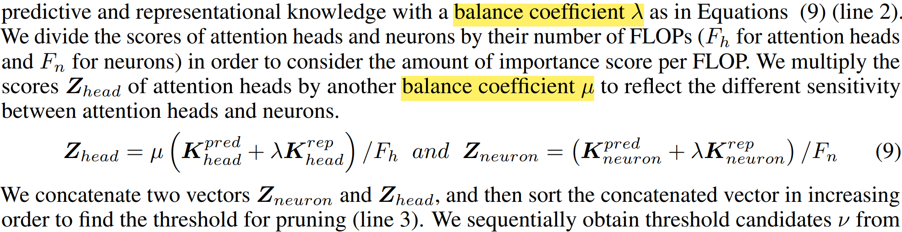

Slide 30
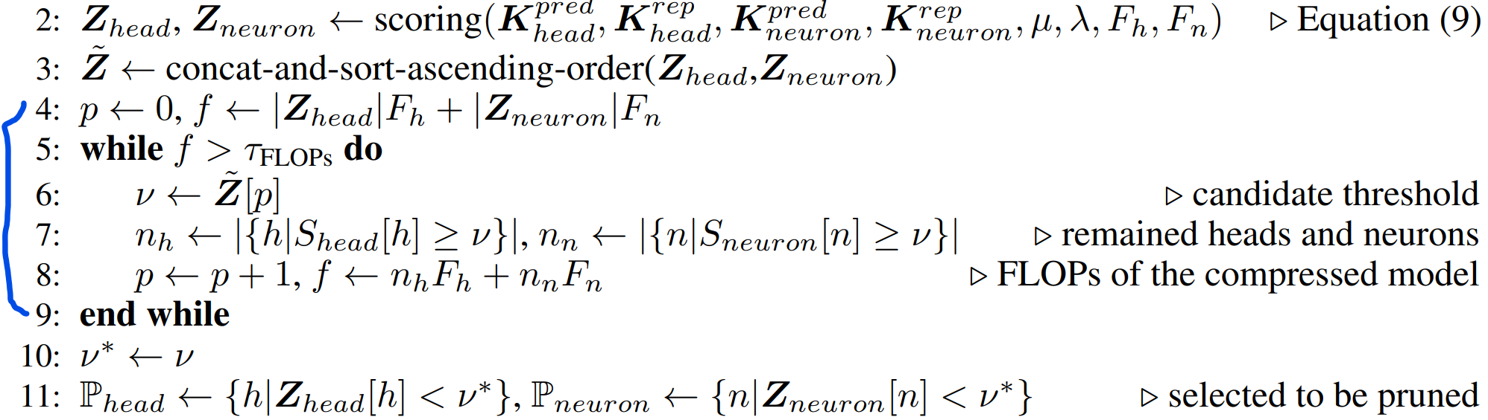
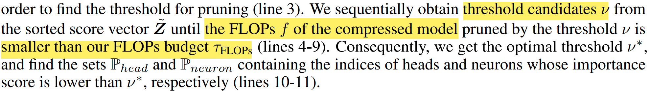

Slide 32
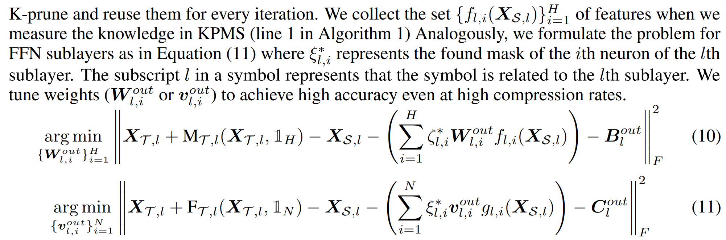

Slide 33
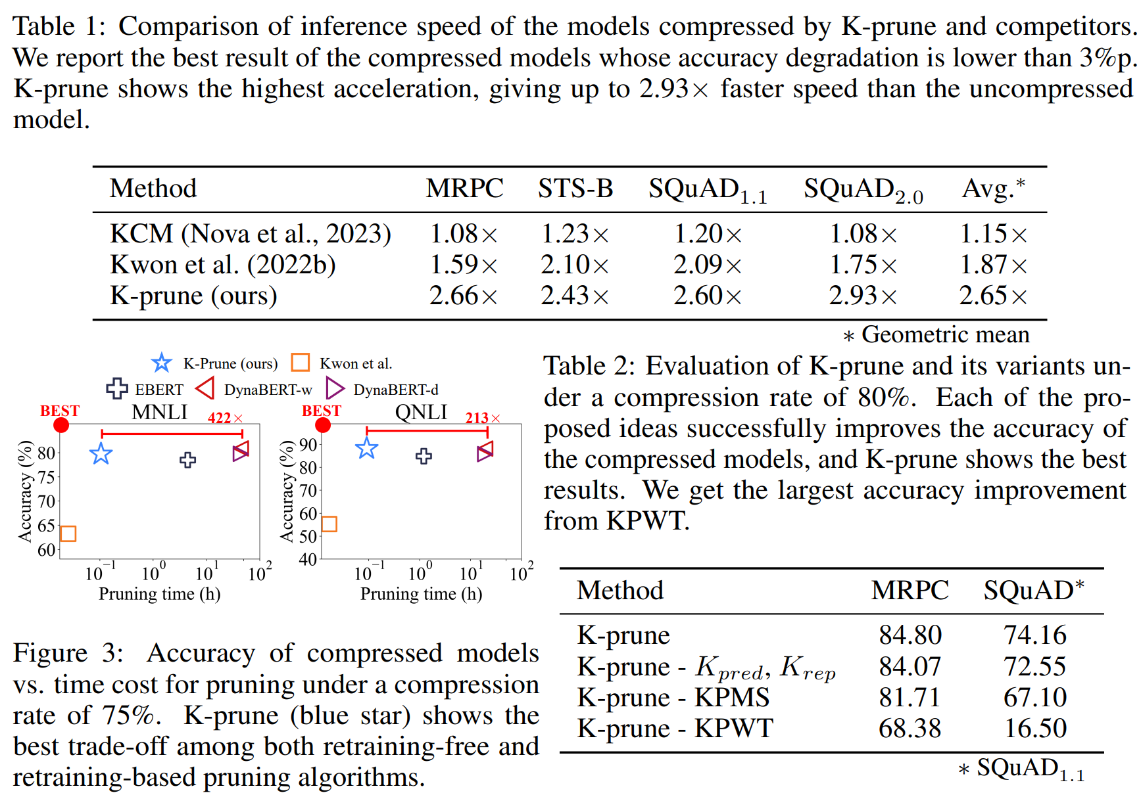

Slide 34
Appendix
[1] Robust Data Pruning under Label Noise via Maximizing Re-labeling Accuracy. NeurIPS 2023.
[2] Dataset Pruning: Reducing Training Data by Examining Generalization Influence. ICLR 2023.
[3] How Does Pruning Impact Long-Tailed Multi-label Medical Image Classifiers? MICCAI 2023.
[4] Balancing Act: Constraining Disparate Impact in Sparse Models. ICLR 2024.
[5] GIO: Gradient Information Optimization for Training Dataset Selection. ICLR 2024.

Slide 35
THANKS

